Slide 1

DEPARTMENT OF COMPUTER SCIENCE Project Presentation (KCS 851) (Chest X-Ray Report Generator)
Guide: Mr. Pawan Kr. Pal (Assistant Professor)
1. Sujal Gupta (2000290120166) Sec: ‘C’
2. Vikas Yadav (2000290120190) Sec: ‘C’
3. Anmol Ratan (2100290128001) Sec: ‘C’

Slide 2
Problem Statement
In the medical field there is a term called Medical Imaging .
X-Ray , ECG, etc are the example of medical imaging.
The specialized machines generate the different types of imaging but it is analysed and read by us humans who specialised in these fields. It is a time consuming process and according to a survey it was observed that 10 min is the average time to generate report manually. Further, after the post covid-19 pandemic, people have become more health conscious and especially for their chest related symptoms and irregularities,
As we are in the digital era we can leverage the power of ML& AI in generating impression reports by training the model to detect any irregularities in their images of X-rays(chest).

Slide 3

Objectives
The primary objective is to automate the process of generating X-ray reports, reducing the time and effort required by healthcare professionals to create them manually.
It will Increase the efficiency of medical staff by providing a tool that can quickly generate reports.
Felicitating the common people to get report of any irregularities in their chest x- ray
Develop a user-friendly and intuitive interface to make it easy to use the application without extensive training.

Slide 4
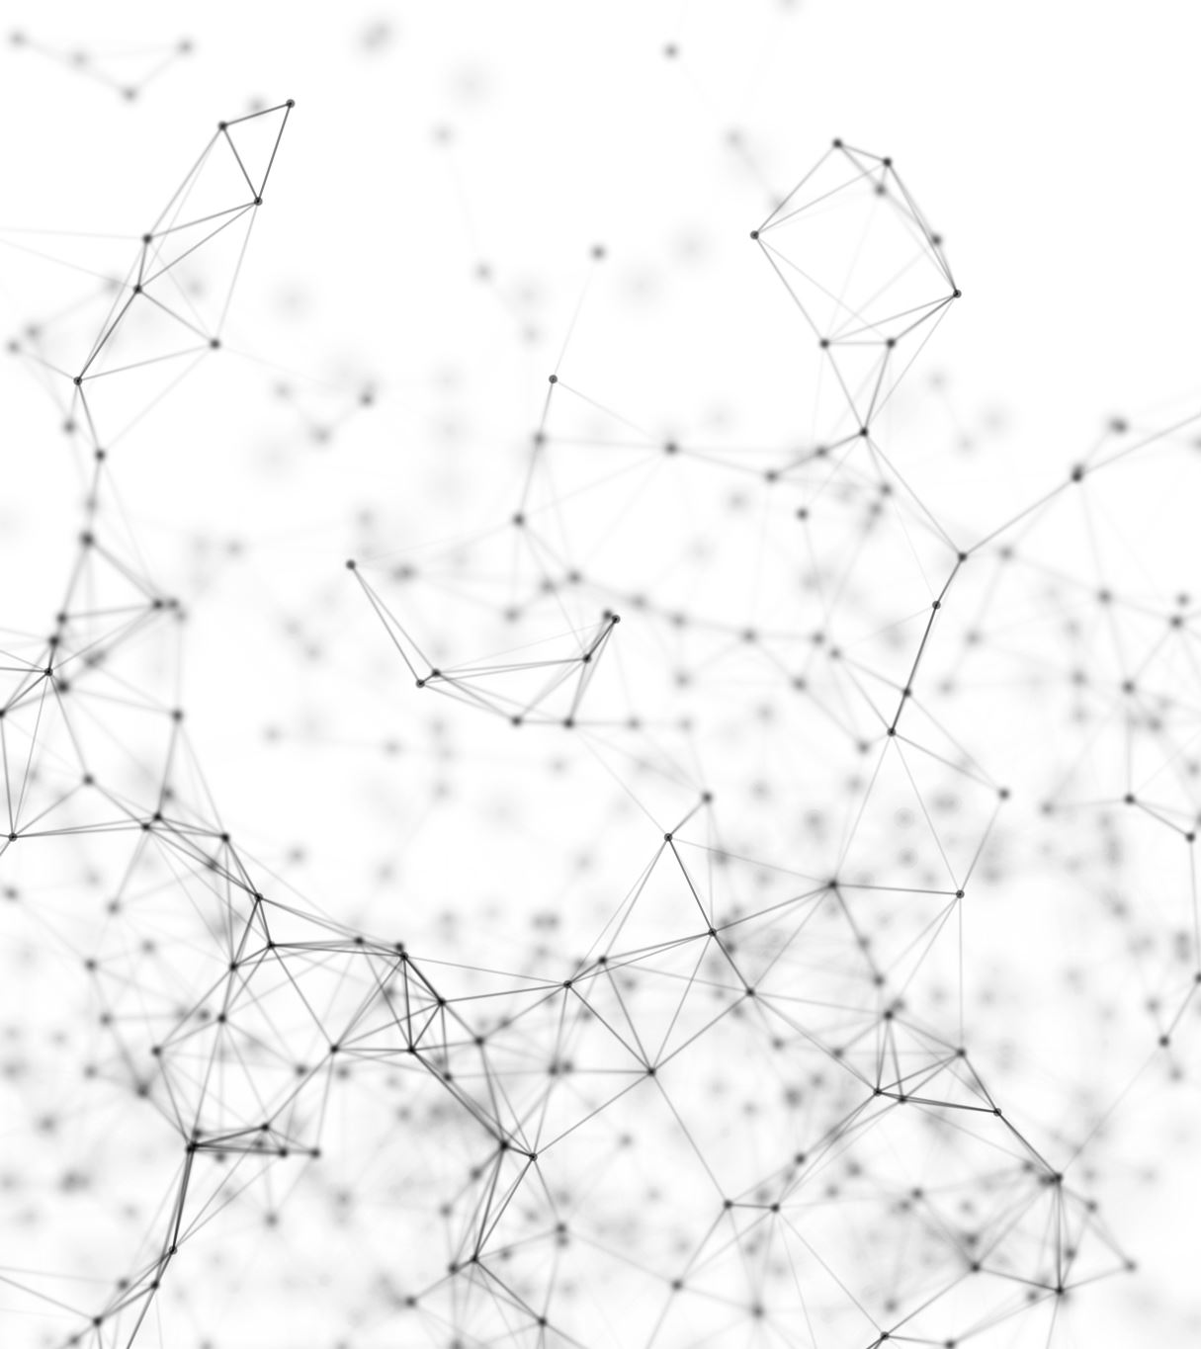
Technology Used
TensorFlow, Keras, Matplotlib, NumPy.(Libraries)
Kaggle. (For Dataset)
indiana uni. dataset (To visualize images of dataset)
Data augmentation. (To train model with various variations)
CNN model. (Deep Learning Model for image processing)
Kotlin(For mobile app development)

Slide 5
Literature Survey
Title: CheXNet: Radiologist-Level Pneumonia Detection on Chest X-Rays with Deep Learning
Author: Pranav Rajpurkar, Jeremy Irvin, Kaylie Zhu, Brandon Yang, Hershel Mehta, Tony Duan
Journal: Cornell University
Year of Publishing: 2017
The author of this study report talked about how chest-based diseases are becoming more common every day and how delayed diagnosis and treatment negatively impacts us diseases like pneumonia is hard to detect and diagnose even. The diagnosis of pneumonia through chest radiography presents a significant challenge for radiologists due to the inherent complexities in interpreting subtle visual cues within X-ray images. This difficulty is compounded by the potential overlap of pneumonia manifestations with other thoracic pathologies, as well as the varied presentation of benign abnormalities. Addressing this need, recent advancements in deep learning have paved the way for the development of sophisticated artificial intelligence models capable of automating pneumonia detection from chest X-ray images. In their seminal work, the authors introduce ChexNet, a state-of-the-art convolutional neural network (CNN) comprising 121 layers. ChexNet demonstrates remarkable proficiency in pneumonia detection, surpassing the performance levels typically achieved by practicing radiologists.

Slide 6
Literature Survey
Title: “Diagnostic Captioning: a survey”
Author: John Pavlopoulos, Vasiliki Kougia, Ion Androutsopoulos and Dimitris Papamichail.
Journal: Springer
Year of publishing: 2022
Diagnostic captioning (DC) concerns the automatic generation of a diagnostic text from a set of medical images of a patient collected during an examination. DC can assist inexperienced physicians, reducing clinical errors. It can also help experienced physicians produce diagnostic reports faster. Following the advances of deep learning, especially in generic image captioning, DC has recently attracted more attention, leading to several systems and datasets. This article is an extensive overview of DC. It presents relevant datasets, evaluation measures, and up-to-date systems. It also highlights shortcomings that hinder DC’s progress and proposes future directions.

Slide 7
Literature Survey
Title: ”Hierarchical X-Ray Report Generation via Pathology tags and Multi Head Attention”
Author: Preeti Srinivasan, Daksh Thapar
Journal: Springer
Year of publishing: 2020
For generating the report and tags, the proposed network learns to extract salient features of the image from a deep CNN and generates tag embeddings for each patient’s X-Ray images. We use transformers for learning self and cross attention. We encode the image and tag features with self-attention to get a finer representation. Use both the above features in cross attention with the input sequence to generate the report’s Findings. Then, cross attention is applied between the generated Findings and the input sequence to generate the report’s Impressions. We use a publicly available dataset to evaluate the proposed network.

Slide 8
Literature Survey
Title: “On the Automatic Generation of Medical Imaging Reports”
Author: Baoyu Jing, Pengtao Xie and Eric P. Xing
Journal: Petuum Inc.
Year of publishing: 2018
First, a complete report contains multiple heterogeneous forms of information, including findings and tags. Second, abnormal regions in medical images are difficult to identify. Third, the reports are typically long, containing multiple sentences. To cope with these challenges, we (1) build a multi-task learning framework which jointly performs the prediction of tags and the generation of paragraphs, (2) propose a co-attention mechanism to localize regions containing abnormalities and generate narrations for them,(3) develop a hierarchical LSTM model to generate long paragraphs.

Slide 9
Literature Survey
Title: ”Evaluating diagnostic content of AI-generated radiology reports of chest X-rays ”
Author: Zaheer Babar, Twan van Laarhoven, Fabio Massimo Zanzotto.
Journal: AI in medicine
Year of Publishing: 2021
Producing a well structured, clear, and clinically well-focused radiology report is essential for high-quality patient diagnosis and care. Despite recent advances in deep learning for image caption generation, this task remains highly challenging in a medical setting. Research has mainly focused on the design of tailored machine learning methods for this task, while little attention has been devoted to the development of evaluation metrics to assess the quality of AI-generated documents. Conventional quality metrics for natural language processing methods like the popular BLEU score, provide little information about the quality of the diagnostic content of AI-generated radiology reports.

Slide 10
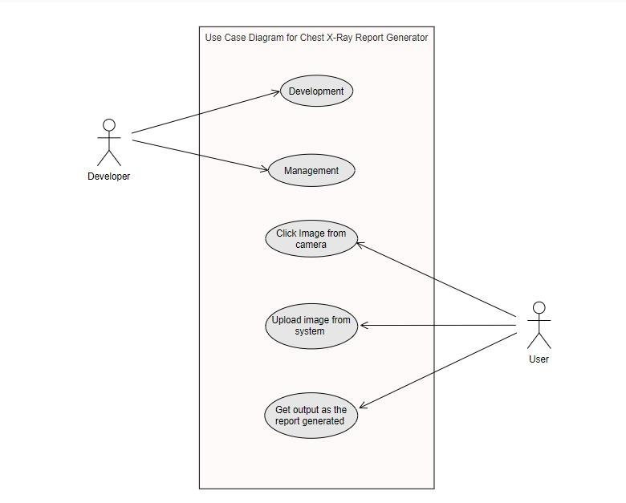
Use-Case Diagram

Slide 11
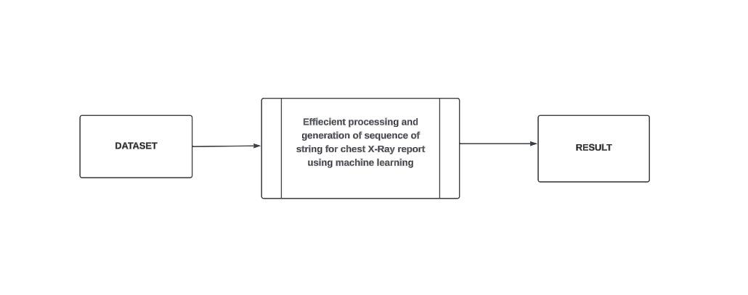
DFD Level 0

Slide 12
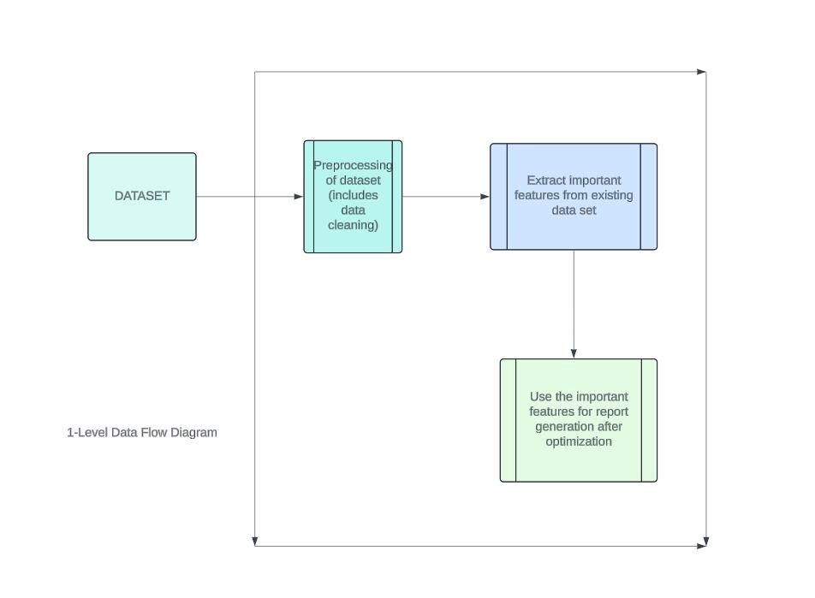
DFD Level 1

Slide 13
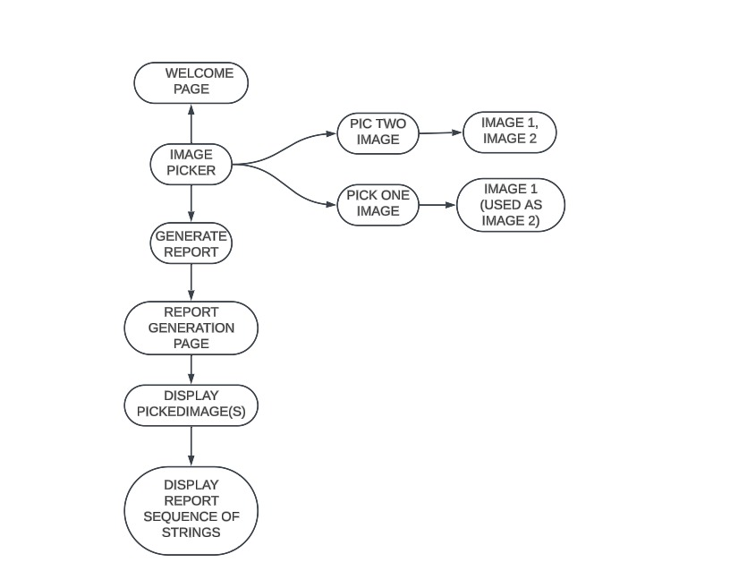
Workflow Diagrams

Slide 14
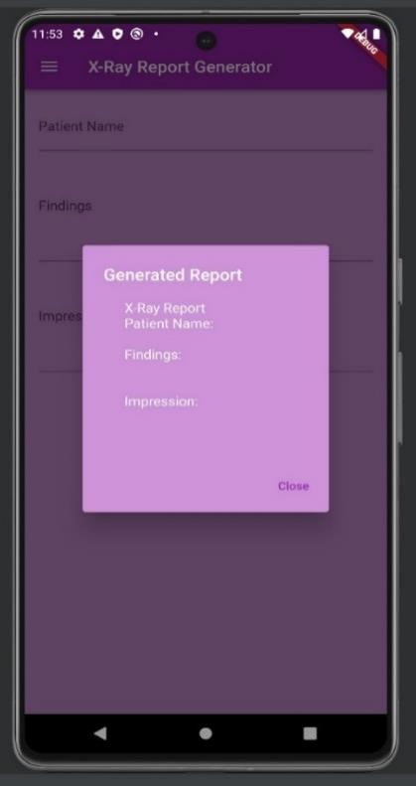
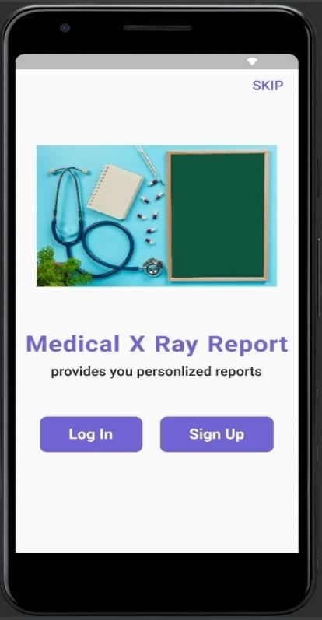
Project Snapshot

Slide 15
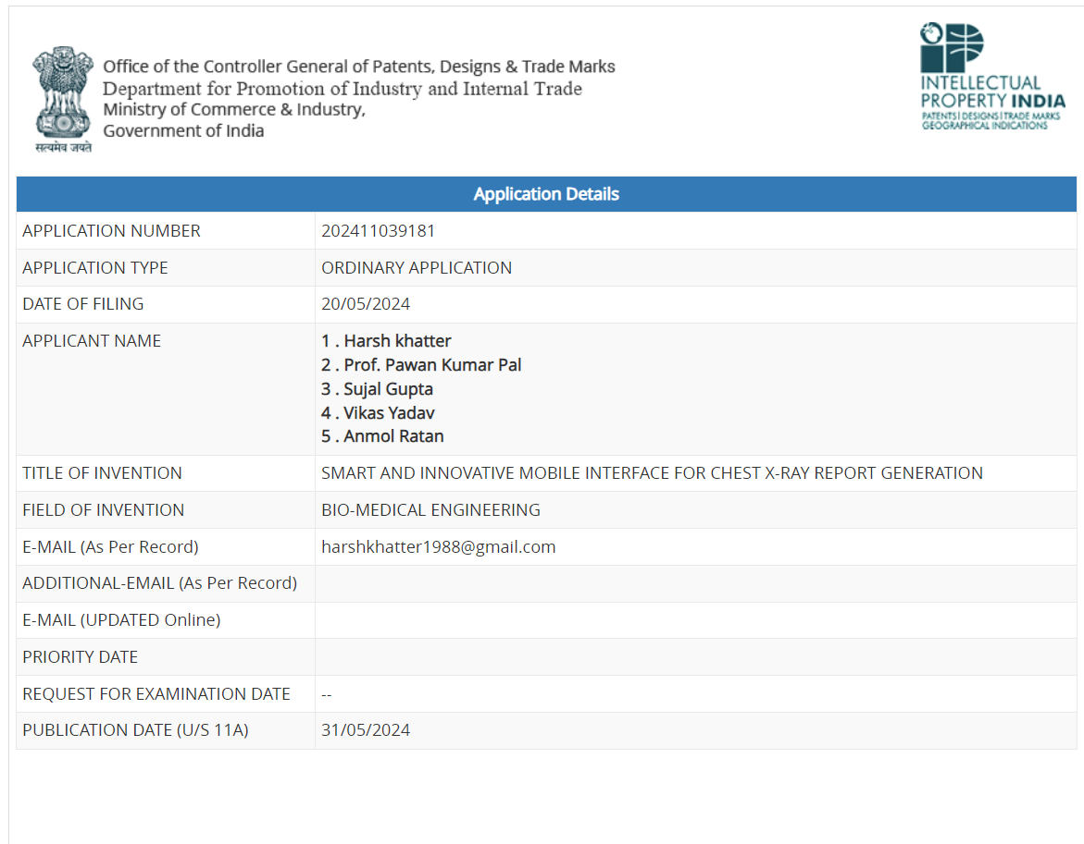
Patent Status

Slide 16
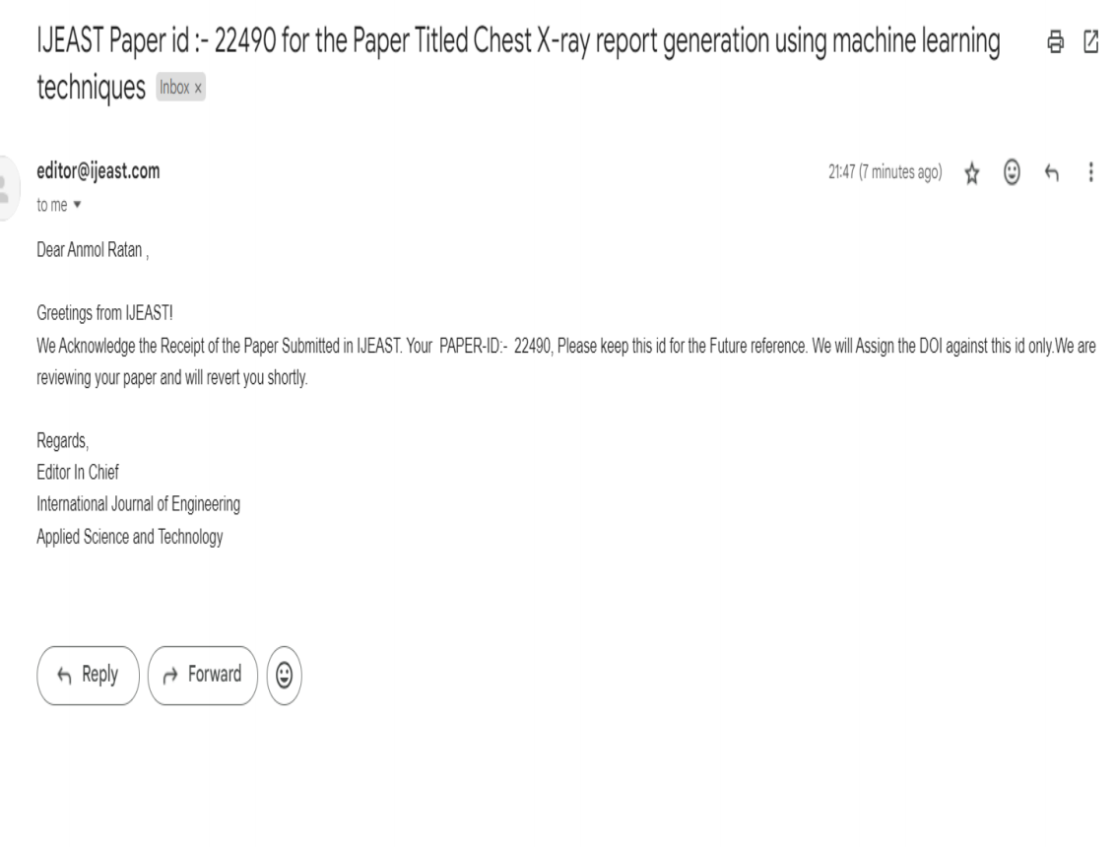
Research Paper Status
Submitted in IJEAST (International Journal of Engineering Applied Science and Technology, 2024)

Slide 17

Project Status
GitHub Link:
https://github.com/KIET-Github/CS-2024-A/tree/main/PCS24-63

Slide 18
All Documents Proof
Test Plan:
https://drive.google.com/file/d/1A3DrajS5JzQGmijzU4POwCCMtnVjSIlW/view?usp=drive_link
Synopsis:
https://drive.google.com/file/d/1J28W7h3JgAFZIx4XDOJ6Bs3zkAbh6coW/view?usp=sharing
SRS:
https://drive.google.com/file/d/1XczrCiSEeSkihSBVBRxtFTY4zjVr3ghOnnsK/view?usp=sharing
Report:
https://drive.google.com/file/d/1RBsz_26ZlRBpNIZitiQQMO0IvSwVtO6C/view?usp=sharing

Slide 19
References
Lukaszewicz A, Uricchio J, Gerasymchuk G. The art of the radiology report: practical and stylistic guidelines for perfecting the conveyance of imaging findings.Can Assoc Radiol J 2016.
Xue Y, Xu T, Long LR, Xue Z, Antani S, Thoma GR, Huang X. Multimodal recurrent model with attention for automated radiology report generation. Proceedings of the international conference on medical image computing and computer-assisted intervention (MICCAI). Granada, Spain: Springer; 2018.
Jimmy Ba, Volodymyr Mnih, and Koray Kavukcuoglu.Multiple object recognition with visual attention. ICLR, 2015.
Razvan Pascanu, Caglar Gulcehre, Kyunghyun Cho, and Yoshua Bengio. How to construct deep recurrent neural networks. ICLR, 2014.

Slide 20
References
Razvan Pascanu, Caglar Gulcehre, Kyunghyun Cho, and Yoshua Bengio. How to construct deep recurrent neural networks. ICLR, 2014.
Aerts HJ, Velazquez ER, Leijenaar RT, Parmar C, Grossmann P, Carvalho S, Bussink J, Monshouwer R, Haibe-Kains B, Rietveld D et al (2014) Decoding tumour phenotype by noninvasive imaging using a quantitative radiomics approach.
Nat Commun 5:1–92. Agrawal H, Desai K, Wang Y, Chen X, Jain R, Johnson M, Batra D, Parikh D, Lee S, Anderson P(2019) nocaps: novel object captioning at scale. In: Proceedings of the IEEE international conference on computer vision, Seoul, Korea, pp 8948–8957
Jing, B., Xie, P., Xing, E.: On the automatic generation of medical imaging reports. ACL (2018)

Slide 21
References
Anderson P, Fernando B, Johnson M, Gould S (2016) SPICE: semantic propositional image caption evaluation. In: Proceedings of the European conference on computer vision, Amsterdam, Netherlands, pp 382–398
Wang, X., Peng, Y., Lu, L., Lu, Z., Summers, R.M.: Tienet: Text-image embedding
network for common thorax disease classification and reporting in chest x-rays. In: Proceedings of the IEEE conference on computer vision and pattern recognition. (2018) 9049–9058
4. Johnson, J., Karpathy, A., Fei-Fei, L.: Densecap: Fully convolutional localization networks for dense captioning. In: Proceedings of the IEEE Conference on Computer Vision and Pattern Recognition. (2016)

Slide 22
THANK YOU

